Slide 1
Linux Administration
Week 4
Dependencies, configurations, Packages and drivers

Slide 2

What is a dependency

Slide 3

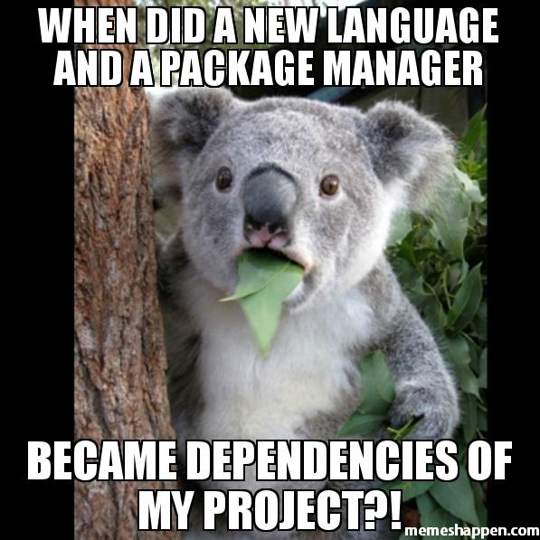
Dependencies
Dependencies happen for saving space and sharing code
Should get warnings if uninstalling packages that are dependencies
Some packages want to be the primary and can cause conflicts
Httpd (apache Web server) vs thttpd (Simpler web server) both want to be primary web server

Slide 4

Dependencies
Version Dependency
Example: Python 2 vs Python 3
Package dependency
Example: OpenSSH has a package dependency of LibSSL
A ton of programs assume you have C libraries installed.
Dependencies and security
Who manages the chain of what you're working on?
Who maintains the code? Repository?

Slide 5
Package Management
Sometimes you download unpacked source code and will need to compile before install because it's not coming from repo
The INSTALL file that includes instructions on how to install the package
Common in projects in C (compiled projects)
Other languages will have required libraries

Slide 6
Example: Gems
RubyGems is the package manager for Ruby
Standard format for distributing programs and libraries
A Gem is supposed to be self-contained format (Gem is the Ruby term for Libraries)
Has a public repo to hold RubyGems
Public Repo is Supposed to help find gems and resolve dependencies
Each Gem should have the code, the documentation and the specs

Slide 7

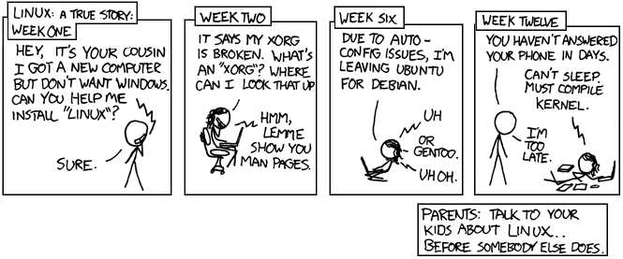




Activity
Install Tmux

Slide 8
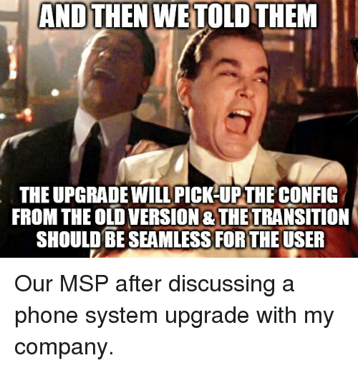
Configuration files
Configuration(or config) files are used to set the initial settings and parameters for programs/system
Usually .cnf .conf or .ini
Could also be .cfg or .cf

Slide 9
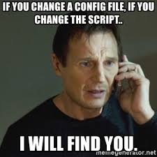
Config editing
Typically config files are plain text and editable in any text editor for easy checking remotely
Almost all allow comments
Comments are used to enable/disable settings
Comments are also used for config documentation
Can be modified
Should create backup if you modify
Some are human readable, some aren't
some have GUIs to help modify (not commonly used)

Slide 10
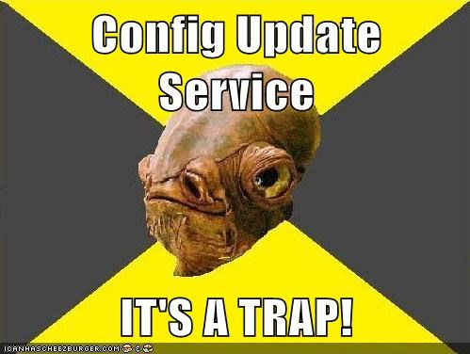
Configs
Checked at startup vs checked more frequently
Common convention says rc in the name means it runs on startup
Example: .bashrc runs on startup
Example: /etc/hosts checked frequently
Some configs can be reloaded once you've made changes
Example: /sbin/service httpd reload

Slide 11
Init.d and system.d
Both daemons
System.d is the newer version of the init framework
Switching from one to the other isn't recommended, and can create errors in your distro
System.d is used to work with services if you use the systemctl commands
Such as systemctl start to start a service
systemctl stop to stop one.
History of issues and bit of a flamewar between the two. https://web.archive.org/web/20220811162347/https://www.tecmint.com/systemd-replaces-init-in-linux/

Slide 12

Activity
Check your SSH config. What are the most important settings in there? What should be changed? What shouldn't?

Slide 13

Drivers
Piece of software to make hardware work properly.
If working right, they are a black box, they hide the details of how the device works, it just works
Can be built separate from the kernel
Mostly the drivers come with your OS
Example: Printer drives come with CUPS (Common Unix Printing System) <-- choose printer based on if driver is available or you might need to write one yourself to get your printer working

Slide 14
Proprietary drivers
Sometimes however the driver doesn't come with the system
Example: Nvidia and AMD graphics hardware <-- Reduced 3D gaming performance
Example: Wi-Fi drivers <-- can lead to reputation of "flaky" Wi-Fi
Some systems have driver managers (Linux Mint)
Some are against proprietary drivers and make it difficult to use them on purpose(Fedora)
If the driver doesn't work easily and can't be found, it might not work at all unless you write a new one yourself.

Slide 15
Troubleshooting
Read error messages
Check internet access (ingress and egress)
Check running services
Try looking at what's running using "top"
Check hardware usage like disk usage, memory usage and available resources
Check your logs!
Check if others have that issue or it's a common problem

Slide 16
Runlevels
Run levels are numbers 0-6 associated with what's going on
We might use this to go into runlevel 1 (single user) if we're running into huge issues on the system and need to kick everyone but admin off.
0 | Halt the system.
1 | Single-user mode (for special administration).
2 | Local Multiuser with Networking but without network service (like NFS)
3 | Full Multiuser with Networking
4 | Not Used
5 | Full Multiuser with Networking and X Windows(GUI)
6 | Reboot.

